Slide 1
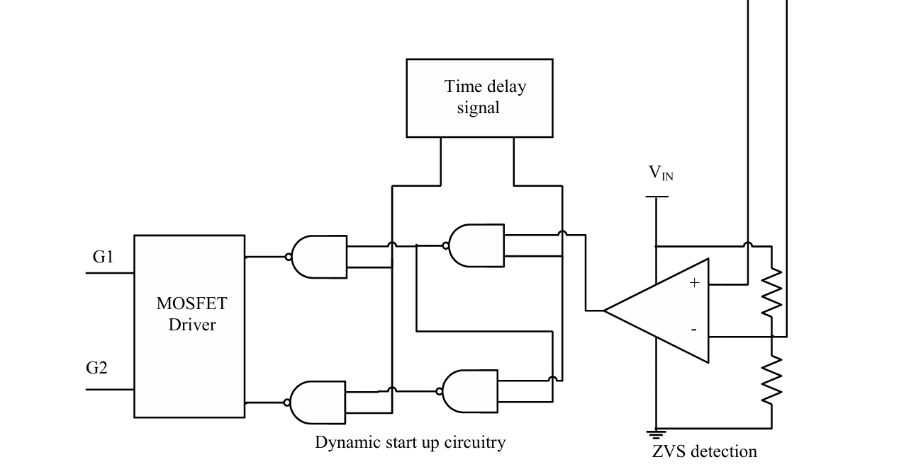
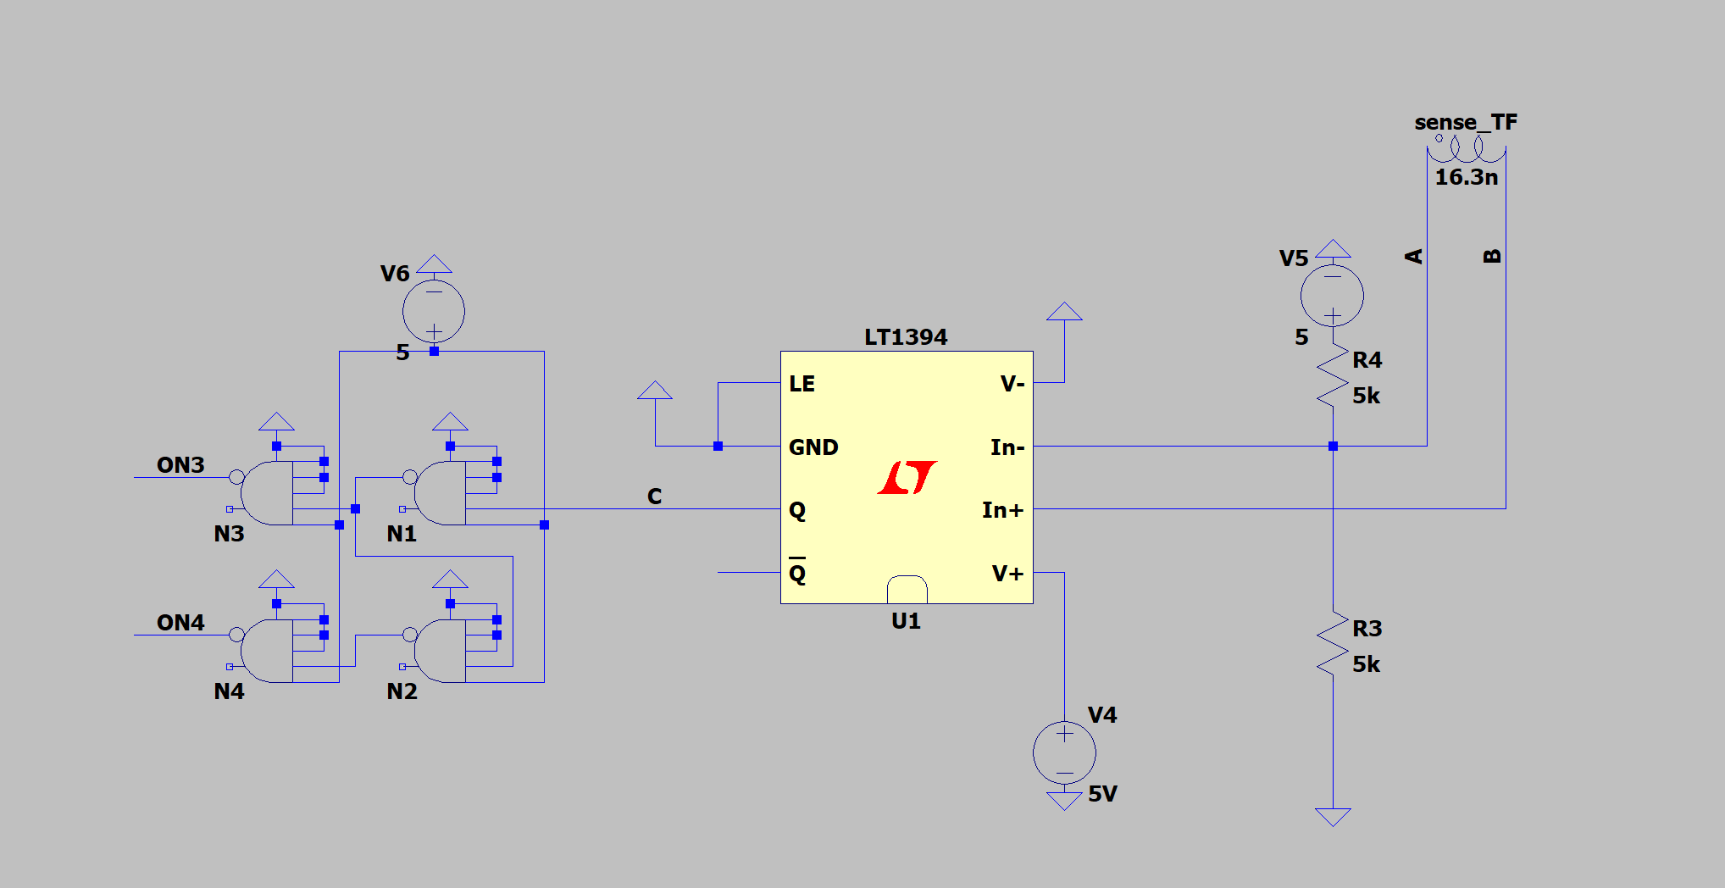
What has been done in the last week?
Implemented the step-down (sense) transformer
Implemented the LT1394 to detect the zero crossings.
Used ideal NAND gates to split the comparator output into two complimentary signals. (Under STEADY-STATE)
Plan for next week:
Find a proper Quad NAND gate IC for LTSpice (or model it)
Construct an RC (low-pass) filter for the time-delay signal to allow for dynamic start-up.
Drive the MOSFETS!

Slide 2
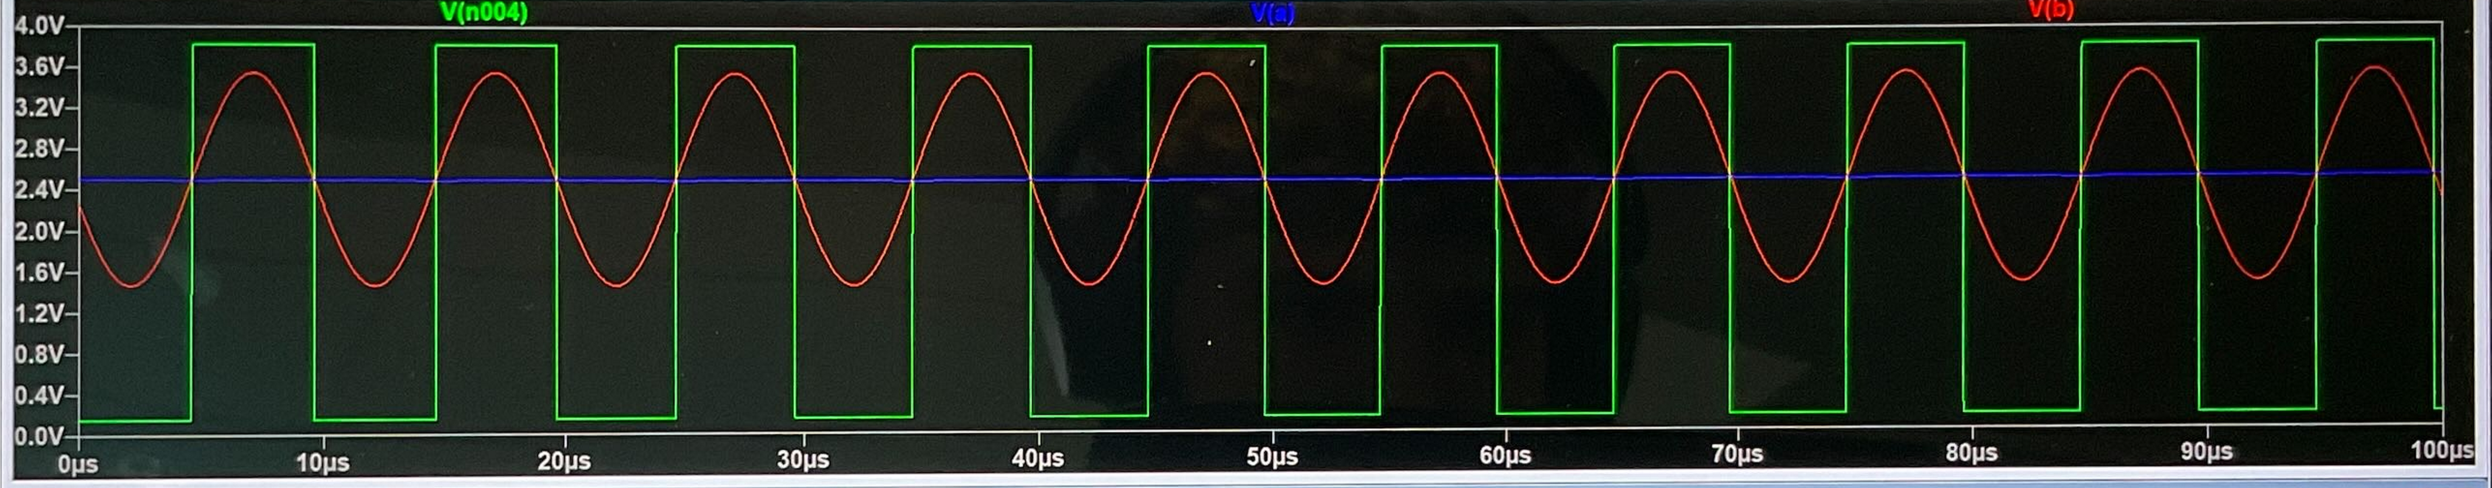
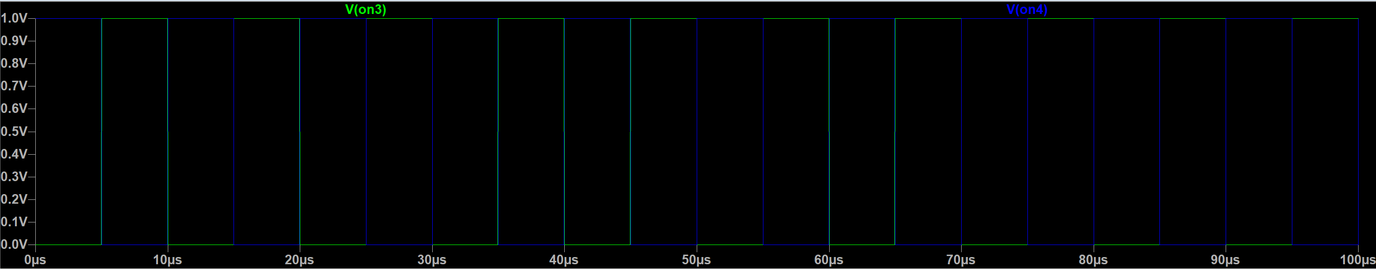
Comparator Input / Output
Quad NAND Gate Output

